Slide 1
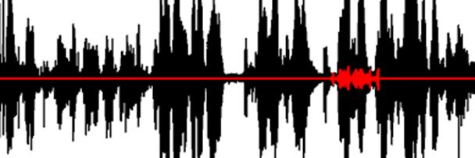

PBL2 - DEEPFAKE DETECTION
High‑Fidelity Audio Watermarking: An End‑to‑End Deep Learning Approach for Imperceptible and Robust Embedding
ATHARVA GONDHALI (22070122038)
AYUSH RANJAN (22070122043)
TRISHA BODA (22070122046)
DIVYANSH KUMAR (22070122056)

Slide 2
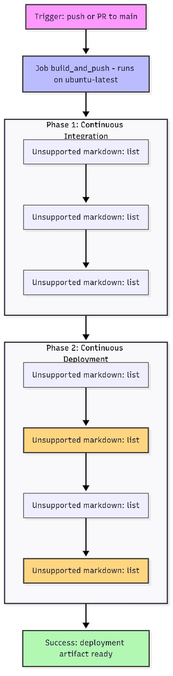
Objective: Automate the build, test, deployment, and monitoring of the Deepfake Detection web app using modern DevOps tools.
Technologies Used:
GitHub Actions – CI/CD automation
Docker – Containerization
Kubernetes – Orchestration
Ansible – Configuration management
Prometheus + Grafana – Monitoring and observability
Architecture Workflow:
Developer pushes code to GitHub → triggers workflow
GitHub Actions builds and pushes Docker image to Docker Hub
Kubernetes deploys the image → creates pods and services
Prometheus collects metrics → Grafana visualizes dashboards

Slide 3
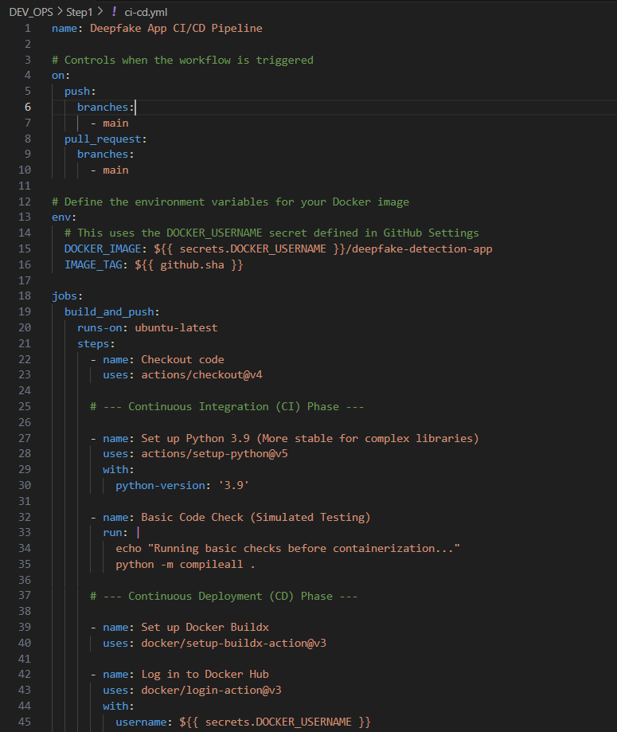
Continuous Integration & Continuous Deployment Workflow
Continuous Integration (CI):
Trigger: push or pull_request to main branch.
Actions:
Checkout repository (actions/checkout@v4)
Set up Python 3.9 environment
Run syntax validation: python -m compileall .
(Optional) Add linting, unit tests, and code analysis
Continuous Deployment (CD):
Build and push Docker image:
Uses docker/build-push-action@v5
Tags image with latest and commit SHA
Kubernetes Deployment:
Applies deployment.yml and service.yaml
2 replicas for high availability
LoadBalancer exposes the app on port 80
Rollout Control:
kubectl rollout status deployment/deepfake-deployment
kubectl rollout undo deployment/deepfake-deployment
kubectl rollout history deployment/deepfake-deployment

Slide 4
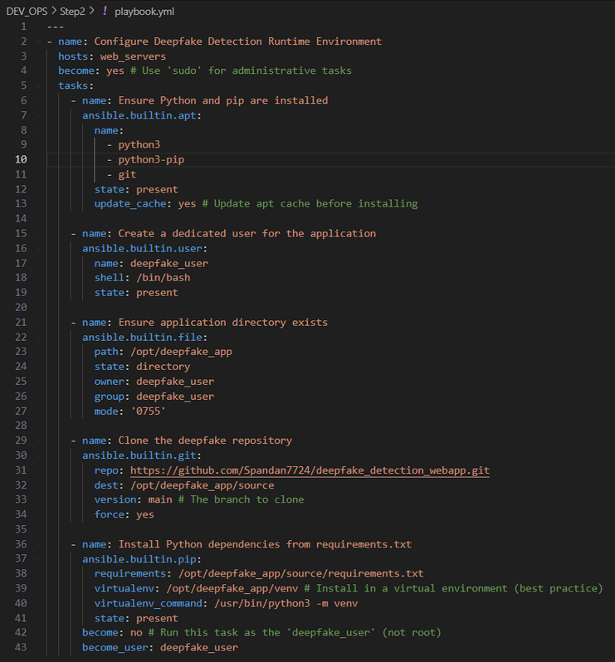
Ansible & Kubernetes Deployment
Ansible Configuration:
Inventory file (inventory.ini): Defines target hosts and SSH users.
Playbook (playbook.yml) automates:
Installing Python, pip, and Git
Creating application user (deepfake_user)
Cloning repo from GitHub
Setting up virtual environment and installing dependencies
Managing permissions and directory structure
Kubernetes Deployment:
Deployment (deployment.yml):
2 pods running the Flask app
Resource limits: 512Mi memory, 500m CPU
Container port: 5000
Service (service.yaml):
Type: LoadBalancer (or NodePort)
Exposes port 80 → routes to container port 5000

Slide 5
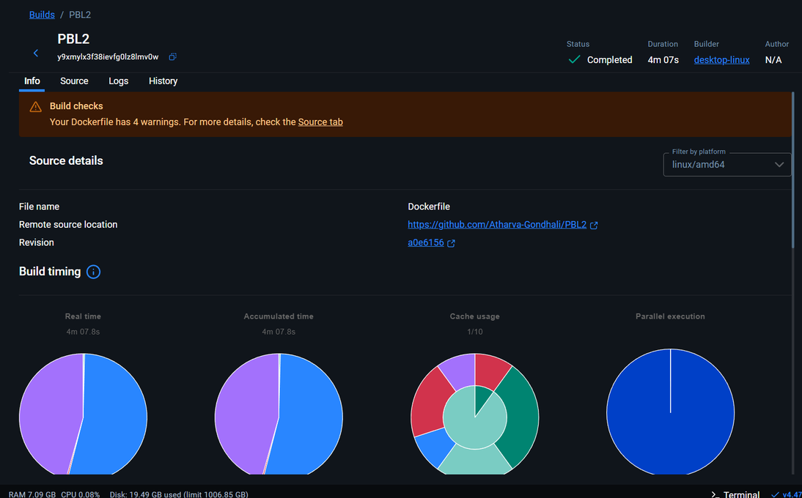
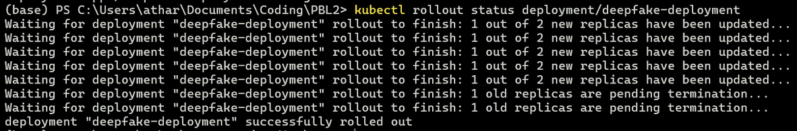

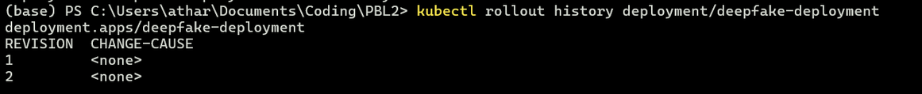
Docker Build Summary
Build Success: Completed in 4 min 7 sec with all stages executed correctly.
Warnings Detected: Related to best practices (e.g. unpinned dependencies, optimization hints).
Visual Insights: Pie charts highlight build timing, cache usage, and parallel execution efficiency.
Successful Deployment Rollout: deepfake-deployment updated successfully with both replicas running the latest version.
Rollout History Inspection: Rollout history shows two revisions, enabling easy tracking of deployment changes.
Successful Rollback : Rollback using kubectl rollout undo verified, demonstrating reliable version control.

Slide 6
Real-Time Monitoring using Prometheus and Grafana
Prometheus Setup:
Collects metrics from:
Deepfake backend (Flask app)
Node Exporter (system metrics)
Key metrics tracked:
http_requests_total
CPU, memory, network usage
Grafana Dashboards:
Node Exporter Dashboard: CPU, memory, disk, and network performance
Application Dashboard: Request count, status codes (200, 307, 404)
Custom Panels: HTTP traffic over time, RAM and disk usage patterns
Alerts (Recommended Enhancements):
Configure Prometheus rules for high CPU/memory usage, pod restarts, and downtime alerts
Integrate notifications via Slack or email

Slide 7
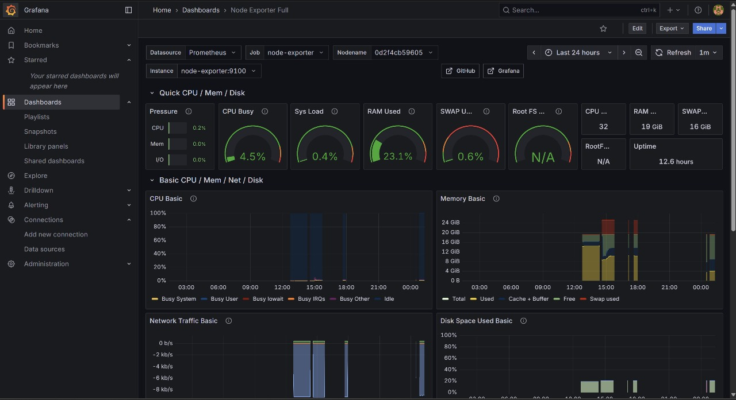
Grafana Dashboard – System Performance Monitoring

Slide 8
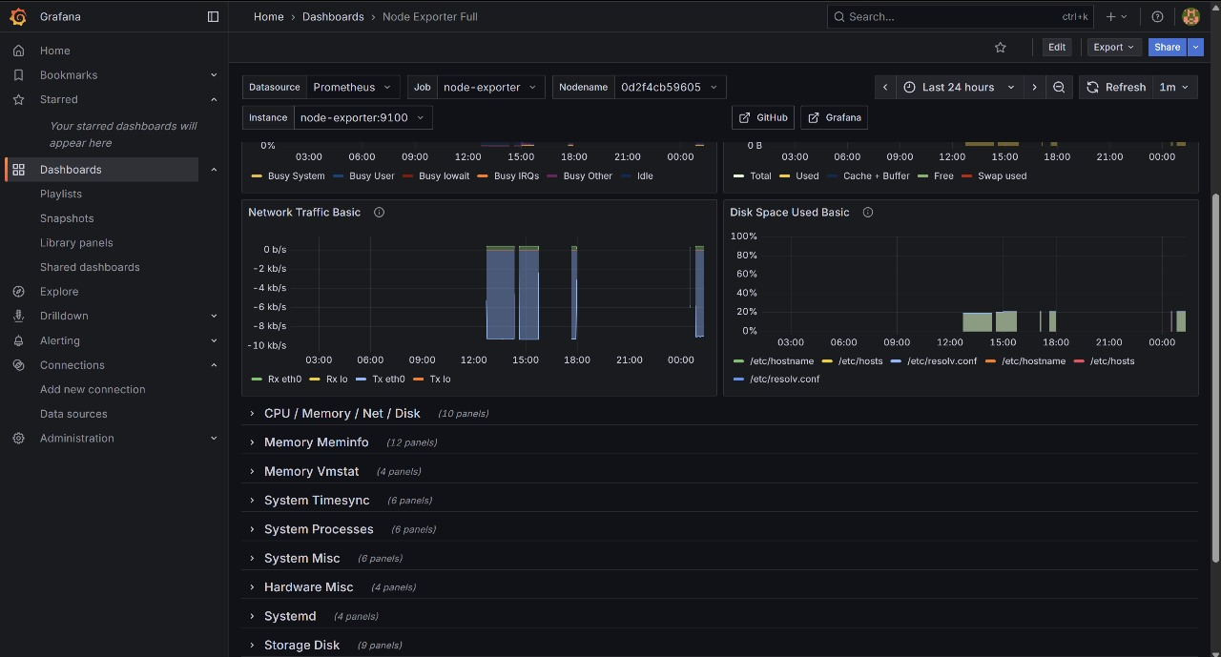
Network, Memory, and Disk Monitoring

Slide 9
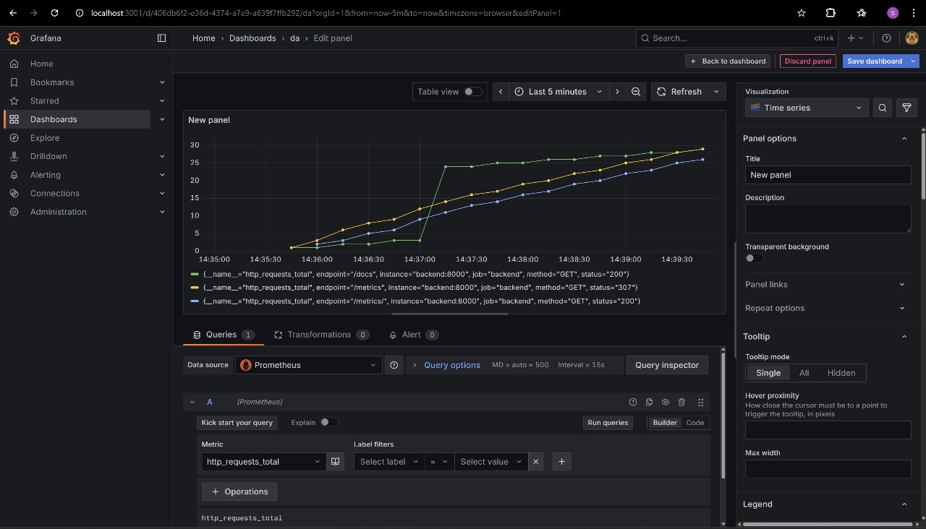
HTTP Requests Monitoring

Slide 10
Challenges Faced
1. Dockerfile warnings (missing `.dockerignore`, large image size)
2. Delayed Kubernetes rollouts due to missing readiness probes
3. Initial Prometheus data delays (resolved by generating traffic)
4. Secret management with GitHub Secrets and Kubernetes Secrets
Lessons Learned
1. Automate all steps (CI/CD, provisioning).
2. Use multi-stage Docker builds to reduce image size.
3. Implement readiness & liveness probes early.
4. Protect credentials via secret management.
5. Monitor continuously with Prometheus & Grafana.

Slide 11
THANK
YOU

